Slide 1


Ownership protection in ML processes
Tanja Sarcevic
SBA Research & TU Vienna
Notes:
2 min

Slide 2
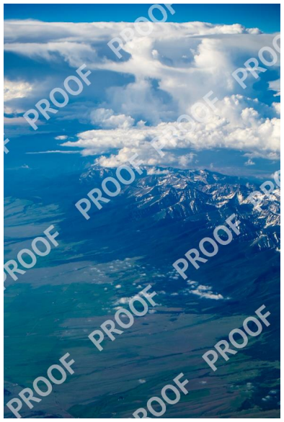

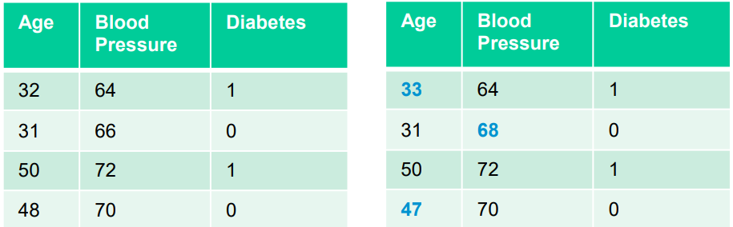
Data fingerprinting and watermarking
Notes:
Problem statement
valuable/sensitive data

Slide 3
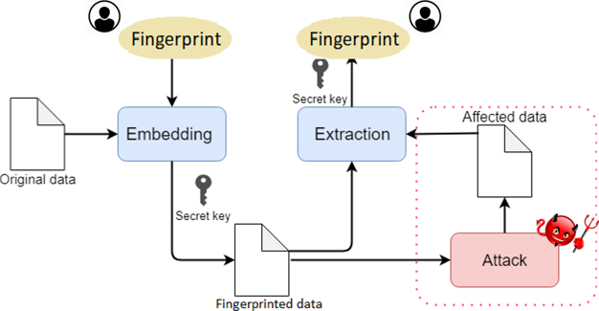
Fingerprinting process
Main ingredients:
hash function
pseudo-random number sequence generator
owner’s secret key
10001011010111011111010100101010

Slide 4
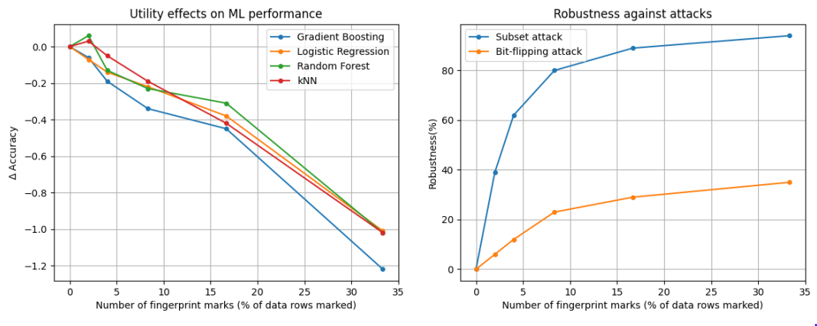
Robustness vs. data utility

Slide 5


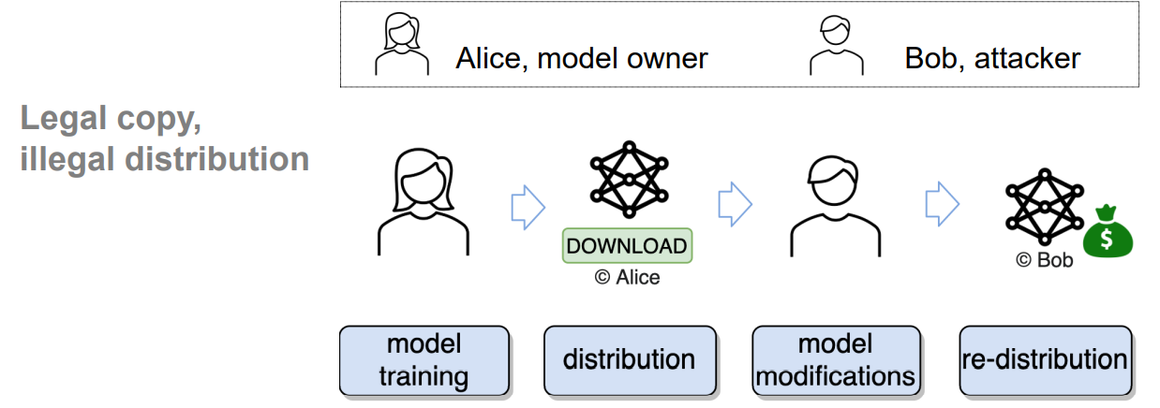
Watermarking ML models
+
?
Someone
Uchida et al.: Embedding Watermarks into Deep Neural Networks https://dl.acm.org/doi/10.1145/3078971.3078974

Slide 6
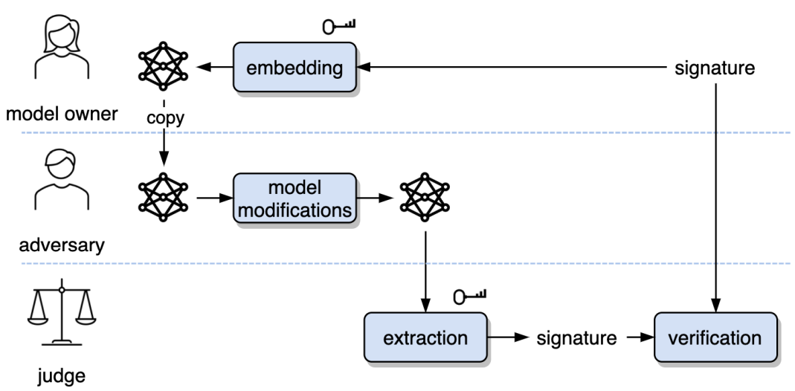
White-box model watermarking

Slide 7
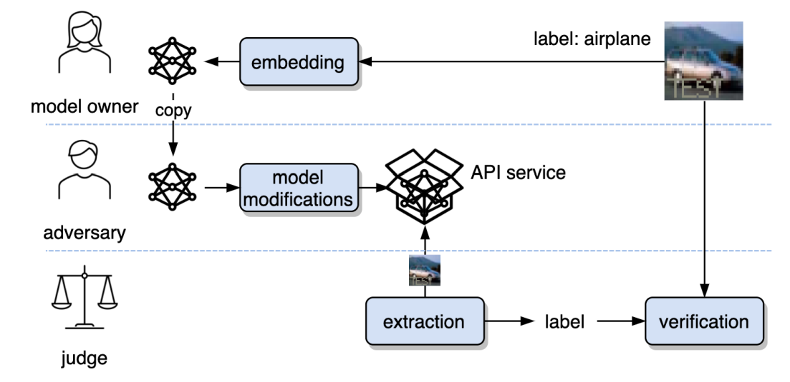
Black-box model watermarking

Slide 8
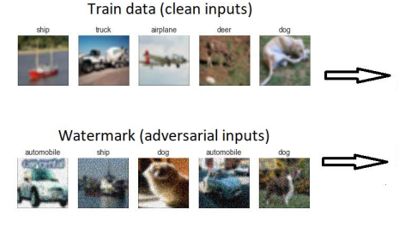
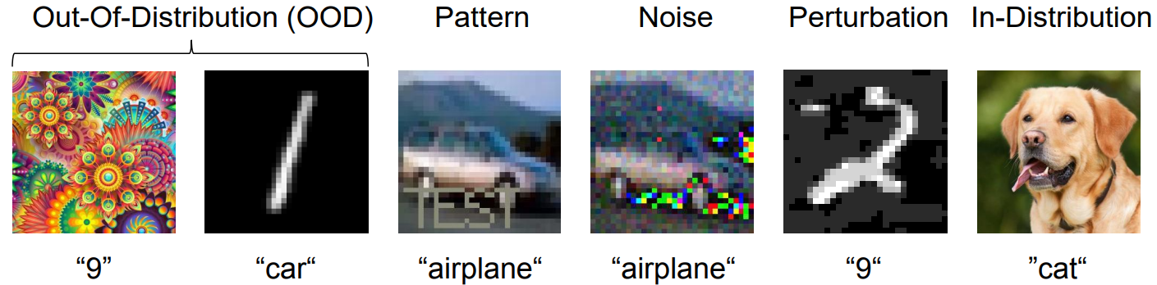
Black-box model watermarking
Trigger images:

Slide 9



Thank you!
https://www.sba-research.org/team/tanja-sarcevic/
/in/tanjasarcevic
github/tanjascats
0000-0003-0896-9193

